Slide 1
Individual Project Presentation
Rana Mittra

Slide 2
Contents
Project Summary
Project Demo
How Training Contributed to the Project
Difficulties
Improvements
Conclusion

Slide 3
Project Summary – Word Generator

Slide 4
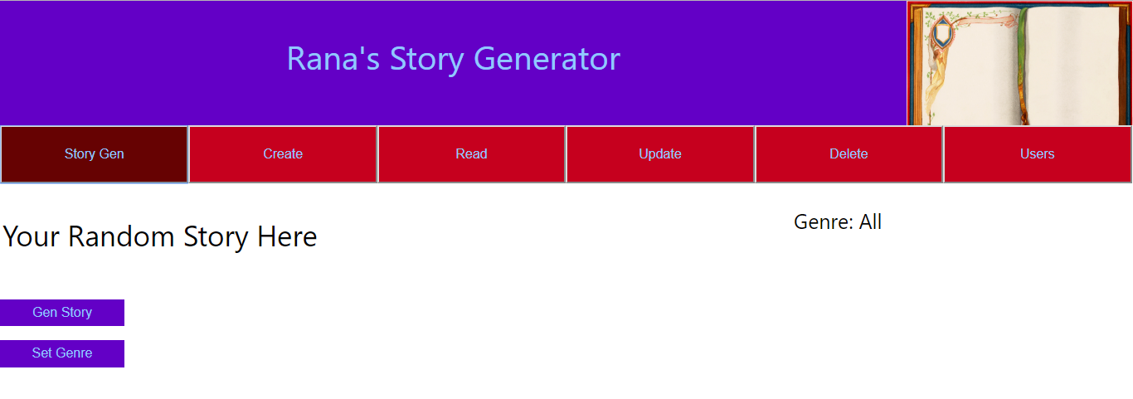
Project Demo
Story Generator

Slide 5
Week 1: Organisation
Trello

Slide 6
Weeks 2&3 - Java

Slide 7
Weeks 4&5 – Upgrading to EE

Slide 8
Week 6 – Front End with JS and React

Slide 9
Week 7 - Testing
Static Testing using Sonarqube
Made a Test Suite.
Code Review by a Peer
Basic Selenium Tests

Slide 10
Challenges
CORS – Fixed allowing 8080 server to allow 3000 server to interact.
Converting to React
Populating Database

Slide 11
Hopes for Improvement
Restructuring website for conditional routing
User exclusive functions
Need to be logged in to use CRU functions.
Admin user who is only one can use delete functions.

Slide 12
Summary

Slide 13
Any questions?

